Slide 1
MongoDB Data Types
Sreejith P Nair

Slide 2
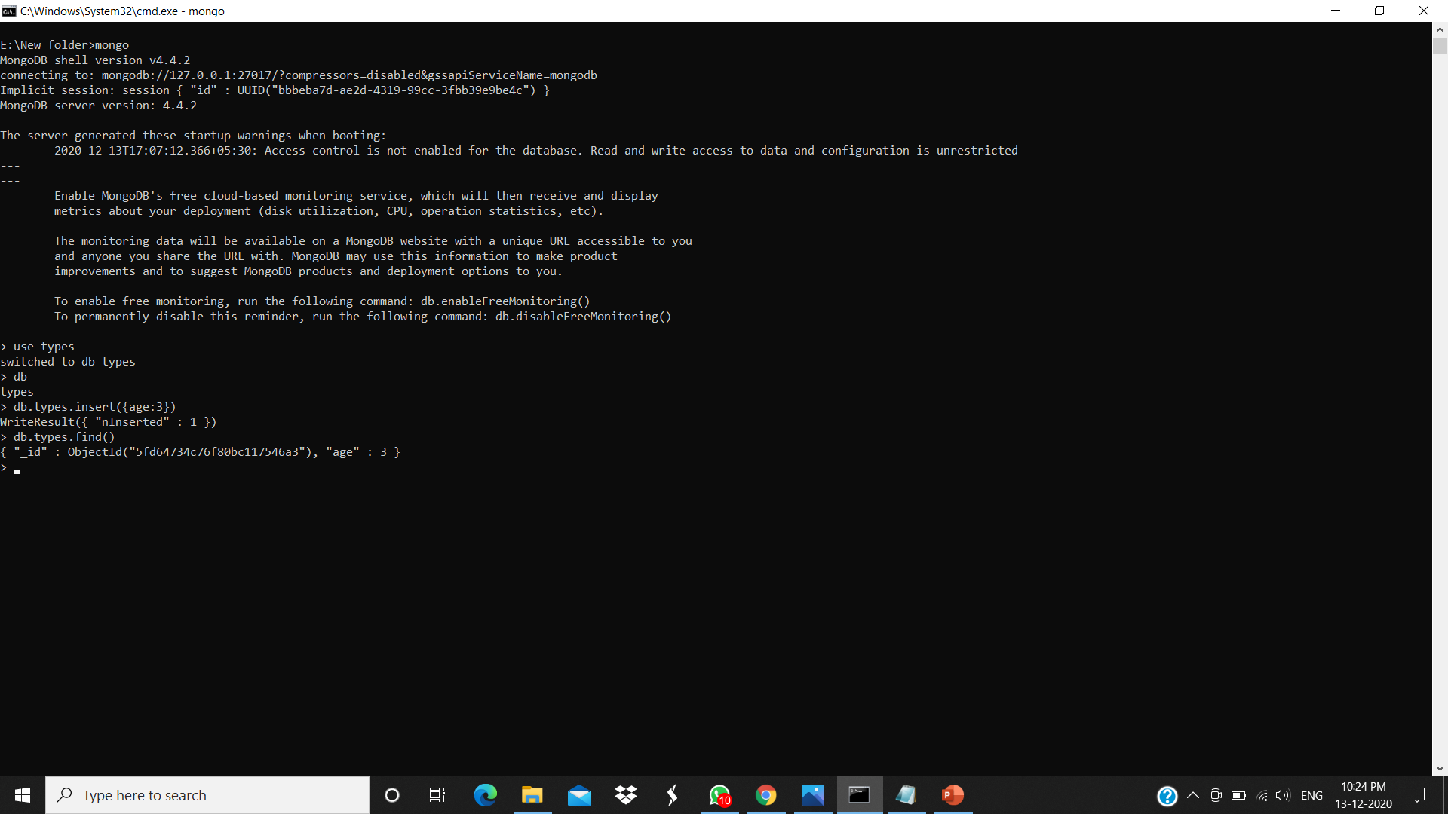
Integer

Slide 3
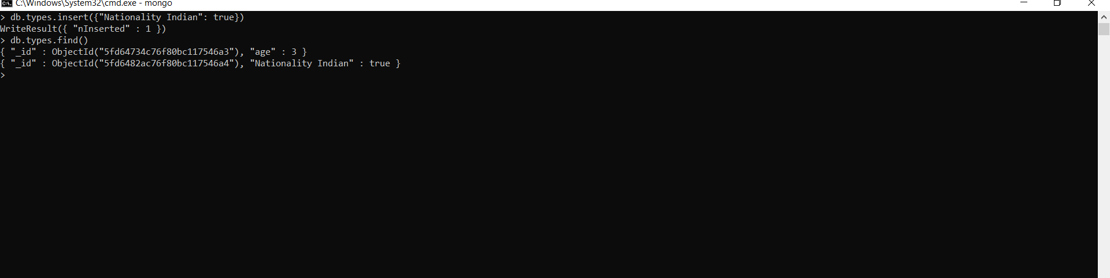
Boolean

Slide 4
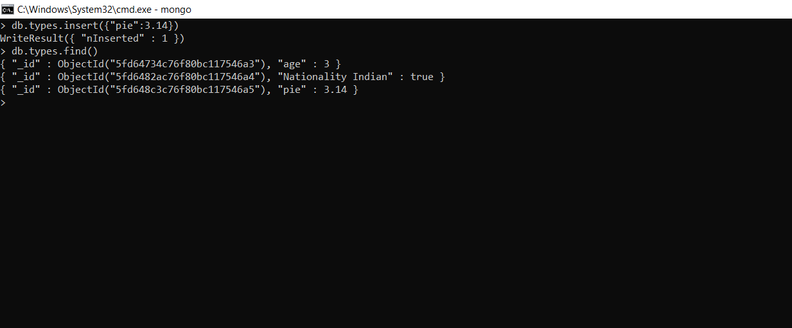
Double

Slide 5

String

Slide 6

Arrays

Slide 7
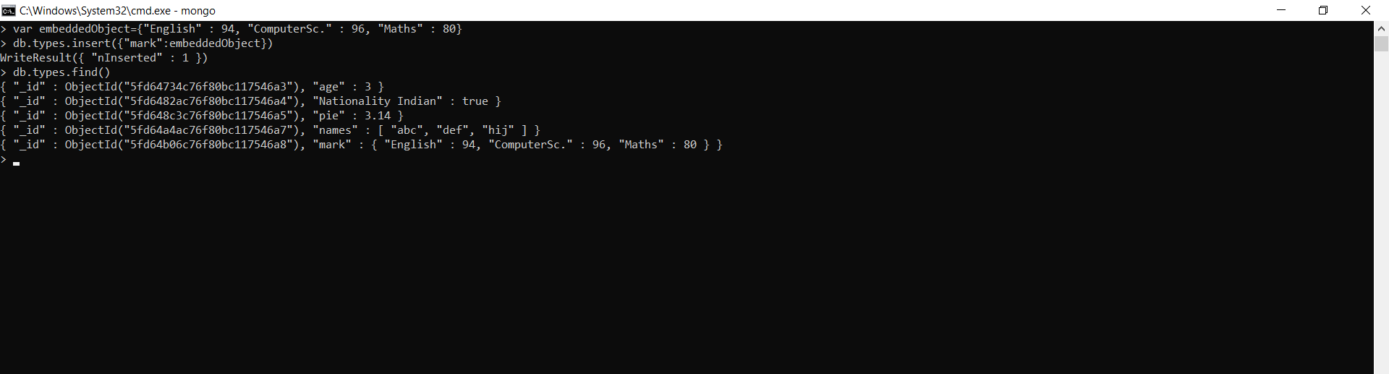
Object

Slide 8

Null

Slide 9

Date

Slide 10

Regular Expressions

Slide 11
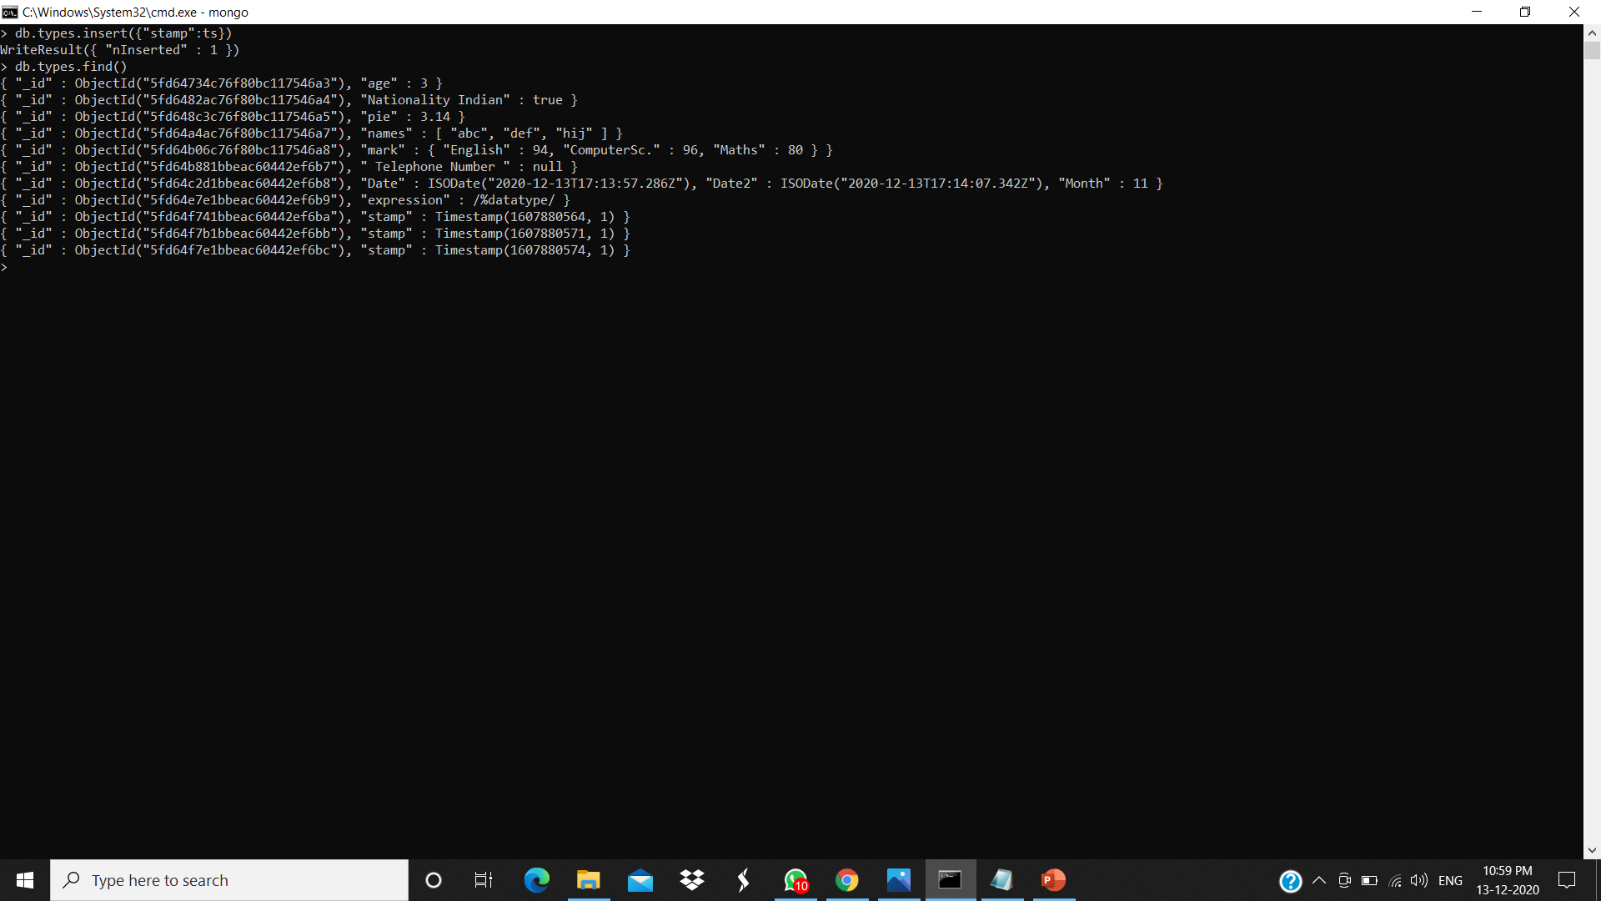
Timestamp

